Slide 1
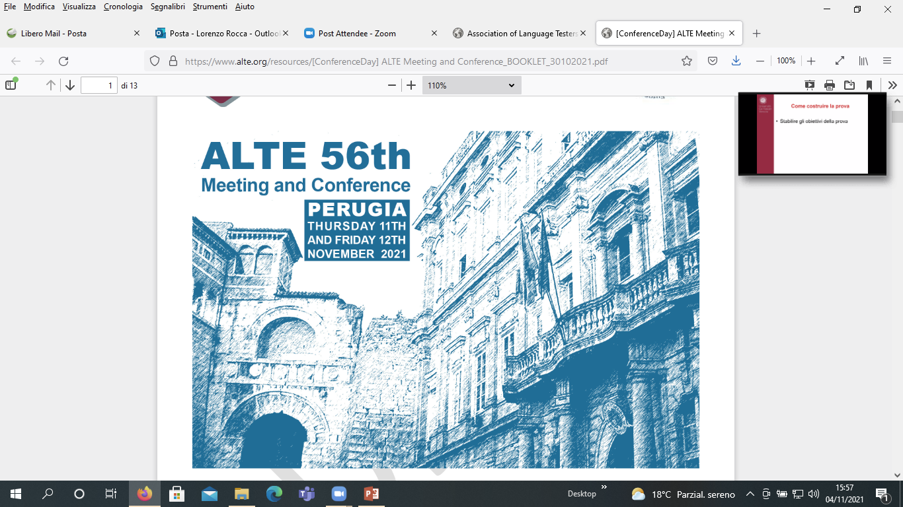
ALTE 56th Conference Day
Connecting teaching
and assessment:
good practices
in the perspective of profiles
12th November 2021
Lorenzo Rocca

Slide 2
Outline
Background
Connections: actors and bridges
Outcomes
What next?
Italian scenario
Migration context

Slide 3





Background
www.associazionecliq.it

Slide 4
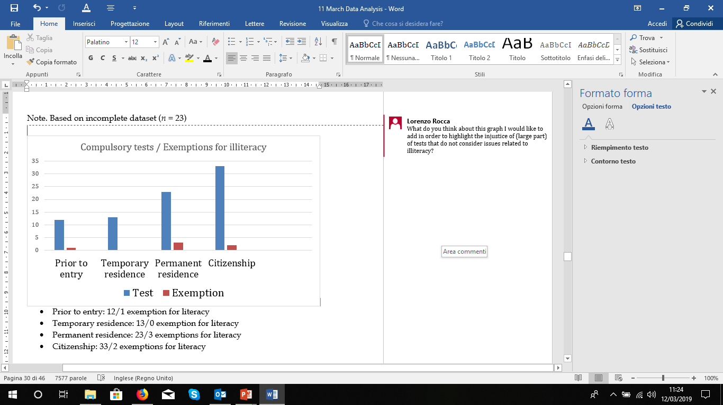

Compulsory tests:
Exemptions for illiteracy
(Rocca, Carlsen & Deygers, 2020)

Slide 5
Mitigating a negative impact
Long interlocutions: CLIQ and Ministry of Interior
Aim: obtaining a partial modification of the law, according to evidences collected
"For the purposes of obtaining the permanent residency [...], in case of verified illiteracy, a language certification based only on oral interaction is issued"
Ministry of Interior, Decision 14/5/2020
Is mitigating really enough?

Slide 6
Raising the bar
Language testers’ advocacy and engagement implies being aware about their responsibilty beyond the test itself
It means taking into account the duty to play a role within the integration as two-way process (CoE, 2005)
“Immigrants should be able to participate fully in the life of the host country, on the basis of equality of rights and opportunities in return for equality of obligations” (CoE, 2021)

Slide 7
A role beyond the test itself
A role within actions aimed to ensure the right to access to education (particularly for the most vulnerable migrants), by guaranteeing that such access can allow the meeting of the language/ KoS requirements (where in place)
Improving learning opportunities (LO)
Monitoring LO quality
Preventing LO issues at different levels
Dealing with LO issues in order to identify solutions
Training the teachers
Collecting and disseminating LO good practices

Slide 8

Connecting
Teaching (T)
Assessment (A)

Slide 9

A bridge called AMIF*
Connecting T & A
*Asylum Migration and Integration (EU) Fund

Slide 10
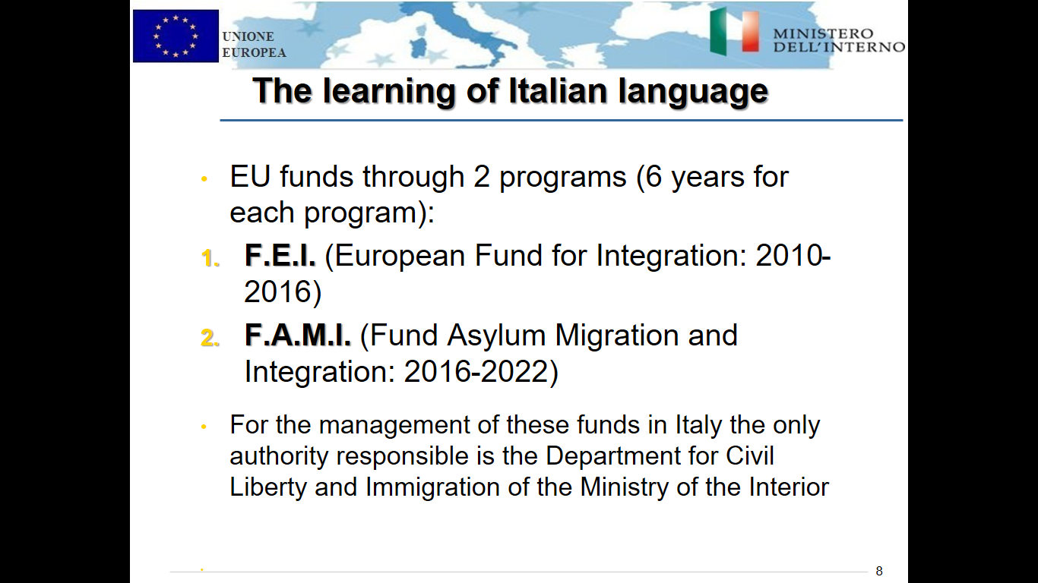
AMIF
Authority responsible: the Department for Civil Liberty and Immigration (DLCI) of the Ministry of the Interior
Beneficiaries (without any charge): third-country nationals aged more than 15 years (all migrants’ profiles, not only refugees)
8 lines of action: priority given to the financing of training activities (€ 84 million in the period 2016-21 for projects at meso level/in all the Italian Regions)
Within these projects, additional funding for the so-called complementary services aimed to facilitate access to and attendance in language courses (i.e. babysitting services, travel costs reimbursement)
In parallel, AMIF projects at macro (national) level, like the ones assigned to CLIQ

Slide 11
Aim
CLIQ national AMIF projects
Synergy with the regional AMIF projects (connecting macro and meso level)
Harmonizing teaching actions, according to common tools, and guidelines
Monitoring quality, trends and outcomes related to the given learning opportunities

Slide 12
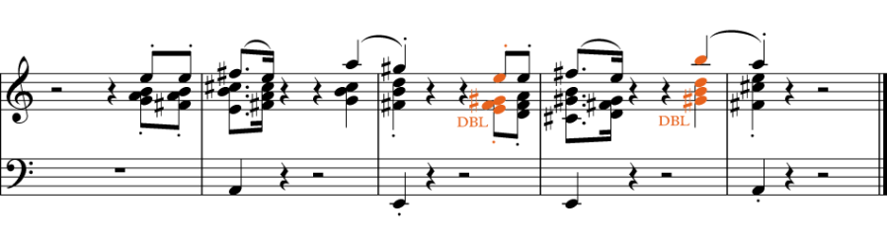
Harmonizing
3 Syllabi
119 Quality indicators
Guidelines for assessment

Slide 13
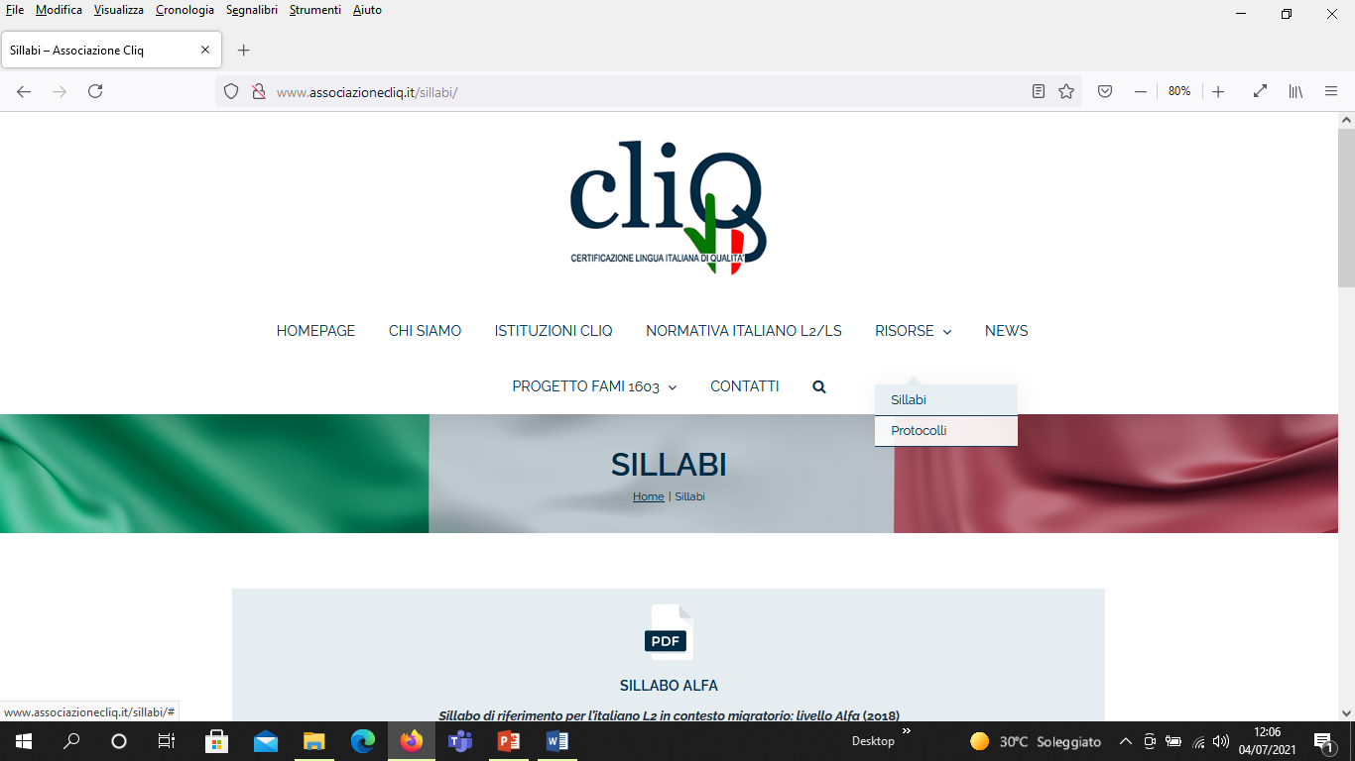
http://www.associazionecliq.it/sillabi/
2016: Syllabi Pre-A1, B1
2018: Syllabus Alfa

Slide 14
Syllabi CLIQ
Complementarity and consistency with the CPIA Guidelines for A1 and A2 (MIUR - Ministry of Education, 2012)
Teaching goals and learners’ profiles described per competences
Such competences declined by
  Skills
  Knowledge (including KoS)
  Communicative situations per CEFR domains

Slide 15

Monitoring
2 aims in detecting:
Good Practices (GP)
Issues
AMIF Regional projects
(courses Alfa, Pre A1, A1, A2, B1)
  Welcome-phase (needs analysis, placement)
  Language activities
  Distance learning
  End-of-course exams

Slide 16
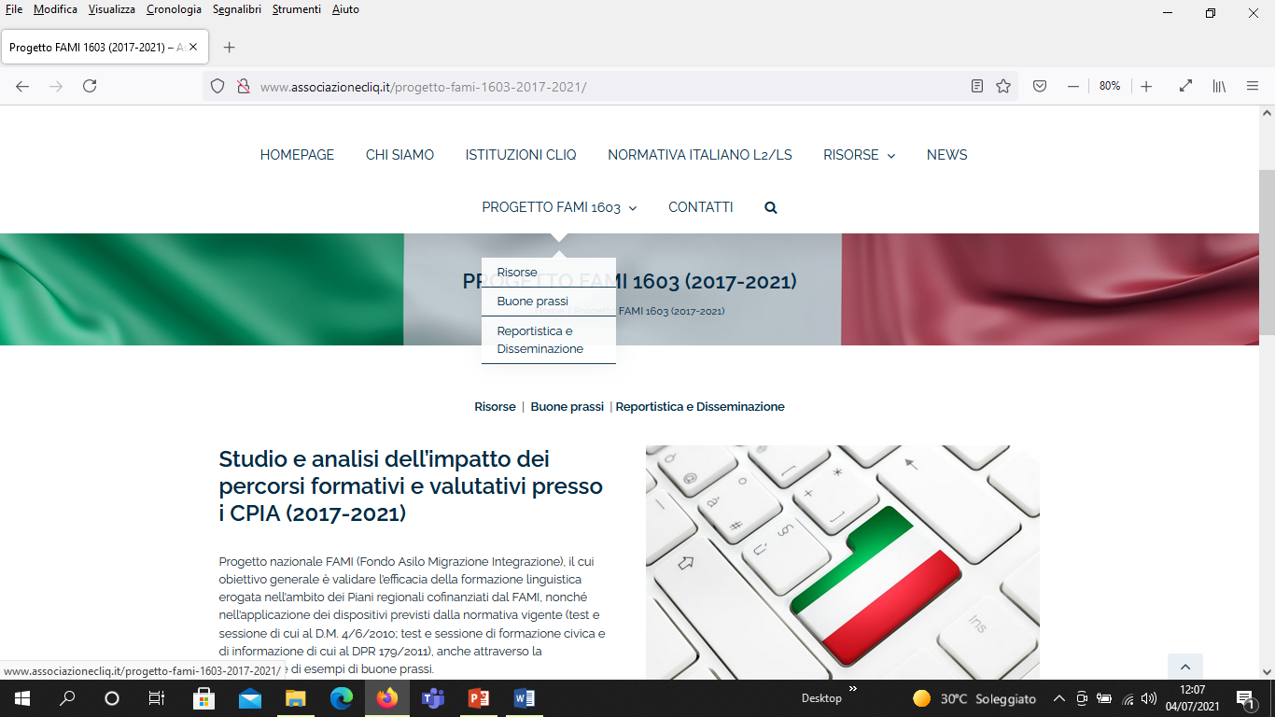
Monitoring
Corpus
12 Regions
27 CPIA visited in loco
25 interviews with heads of CPIA
1283 questionnaires (teachers and learners)

Slide 17
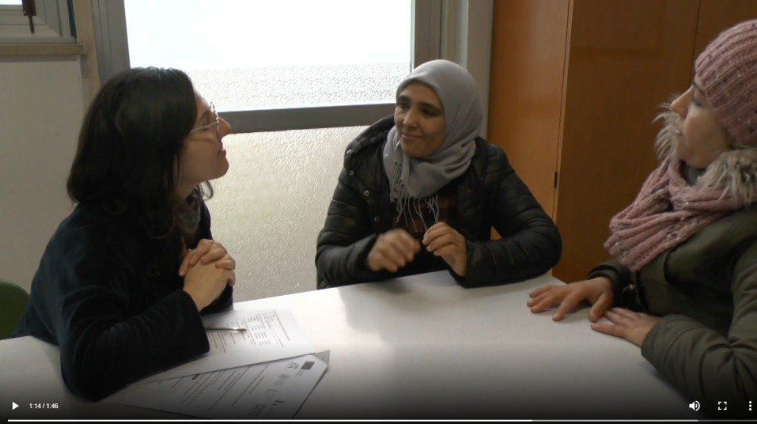
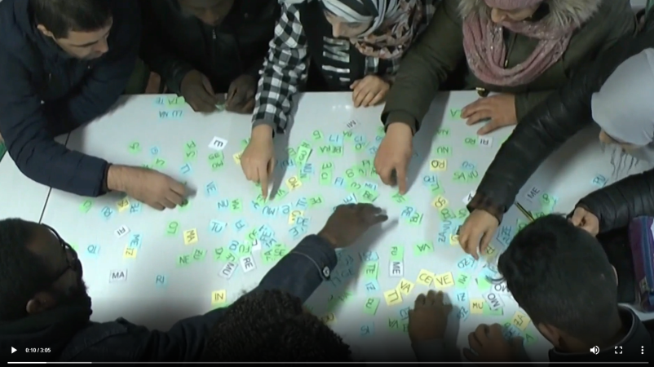
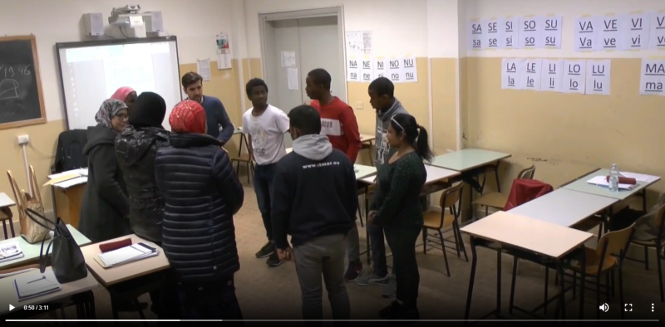
GP - repertory
38 tools
5 videos

Slide 18
A main issue
Improving modularity
Targeted, shorter and more sustainable learning modules
focused on the gap to be filled or on the CEFR categories in order to meet better users' literacy and language needs (according to their uneven profiles)
focused on specific topics (also KoS contents), in order to meet better users' needs (according to their daily life)
“Learning programs and certification can be […]:
modular, improving the learner’s proficiency in a restricted area for a particular purpose. A considerable role may be played by modules geared to the specific needs, characteristics and resources of learners
partial, taking responsibility only for certain activities/ skills”
(CEFR, 2001: 6-7)

Slide 19
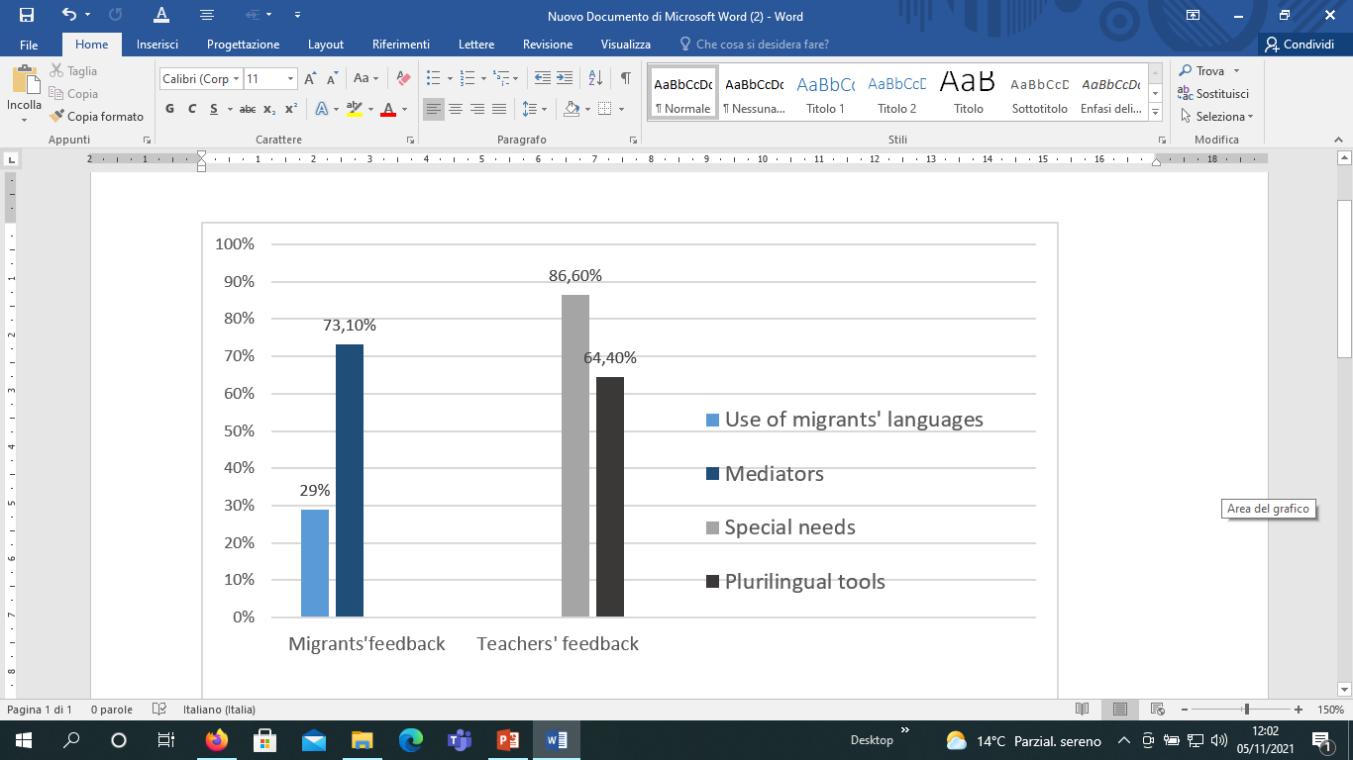
Other issues
Not (enough)
provided

Slide 20
Other issues
Not (enough)
provided

Slide 21
Looking at AMIF new edition (2022-2027)
Tasks for CLIQ
Detecting and disseminating GP (as ongoing process)
Implementing modularity
Strengthening mediation and support-teachers for learners with special needs
Training teachers and developing tools aimed to sustain plurilingualism for a better quality education
Quality education is founded on the idea of plurilingualism (CoE, 2008), defined by the CoE as “[…] the repertoire of varieties of language which many individuals use […]; it includes the language variety referred to as ‘mother tongue’ or ‘first language’ and any number of other languages or varieties” (Krumm & Plutzar, 2008)

Slide 22
Challenges for CLIQ
Confirming, improving and highlighting the broader role of language testers for LIAM, beyond the test itself
Ensuring sustainability to such role in terms of national policy, by managing to switch from “one-shot projects” to the constitution of a permanent Observatory:
  coordinated by CLIQ and based on a committee including Ministry of Education (MIUR, CPIA department) and Ministry of Interior (DLCI)
  aimed to allow a continuous harmonizing and monitoring of actions undertaken for LIAM

Slide 23
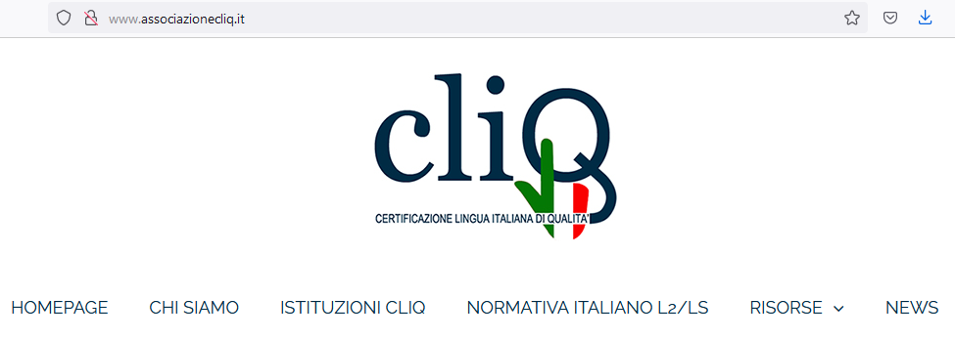

Grazie
l.rocca@ladante.it

